Slide 1

Airline passenger Satisfaction Prediction
Using Data Science and Machine Learning
Project by: Jignasa Dhokiya
Date: 23/09/2023

Slide 2
Introduction
Airline customer satisfaction refers to the level of contentment and approval that passengers feel after using the services of an airline company. It is a crucial metric for airlines as it directly impacts their reputation, customer loyalty, and business success. A higher level of customer satisfaction often leads to increased customer retention, positive word-of-mouth referrals, and a competitive edge in the airline industry.
Customer Satisfaction Factors:
On-Time Performance
In-Flight Experience
Booking Process
Customer Service
Baggage Handling

Slide 3
Introduction
Measuring Satisfaction: Airlines measures customer satisfaction through post-flight surveys, feedback forms, and online reviews. Passengers are encouraged to share their experiences and rate various aspects of their journey, including check-in, boarding, in-flight services, and overall experience. The airline uses Customer Satisfaction Score metrics to quantify satisfaction levels.
Improving Satisfaction: Based on customer feedback and survey results, Airlines continuously strives to improve its services. They invest in staff training, upgrade their fleet, and implement technology enhancements to address pain points and enhance the overall customer experience.

Slide 4
Goals
This dataset contains an airline passenger satisfaction survey.
What factors are highly correlated to a satisfied (or dissatisfied) passenger?
Can we predict passenger satisfaction?

Slide 5
Data source
We'll be working with an Airline Passenger Satisfaction data which is downloaded from Kaggle.
Features: 25
Instances: 103904

Slide 6
content
Gender: Gender of the passengers (Female, Male)
Customer Type: The customer type (Loyal customer, disloyal customer)
Age: The actual age of the passengers
Type of Travel: Purpose of the flight of the passengers (Personal Travel, Business Travel)
Class: Travel class in the plane of the passengers (Business, Eco, Eco Plus)
Flight distance: The flight distance of this journey
Inflight wifi service: Satisfaction level of the inflight wifi service (0:Not Applicable;1-5)
Departure/Arrival time convenient: Satisfaction level of Departure/Arrival time convenient
Ease of Online booking: Satisfaction level of online booking
Gate location: Satisfaction level of Gate location
Food and drink: Satisfaction level of Food and drink
Online boarding: Satisfaction level of online boarding
Seat comfort: Satisfaction level of Seat comfort
Inflight entertainment: Satisfaction level of inflight entertainment
On-board service: Satisfaction level of On-board service
Leg room service: Satisfaction level of Leg room service
Baggage handling: Satisfaction level of baggage handling
Check-in service: Satisfaction level of Check-in service
Inflight service: Satisfaction level of inflight service
Cleanliness: Satisfaction level of Cleanliness
Departure Delay in Minutes: Minutes delayed when departure
Arrival Delay in Minutes: Minutes delayed when Arrival
Satisfaction: Airline satisfaction level(Satisfaction, neutral or dissatisfaction)

Slide 7
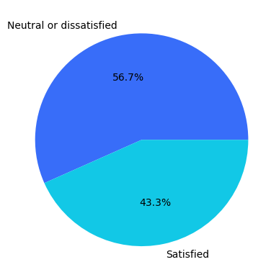
Satisfaction:
Airline satisfaction
level(Satisfaction, neutral or
dissatisfaction)

Slide 8
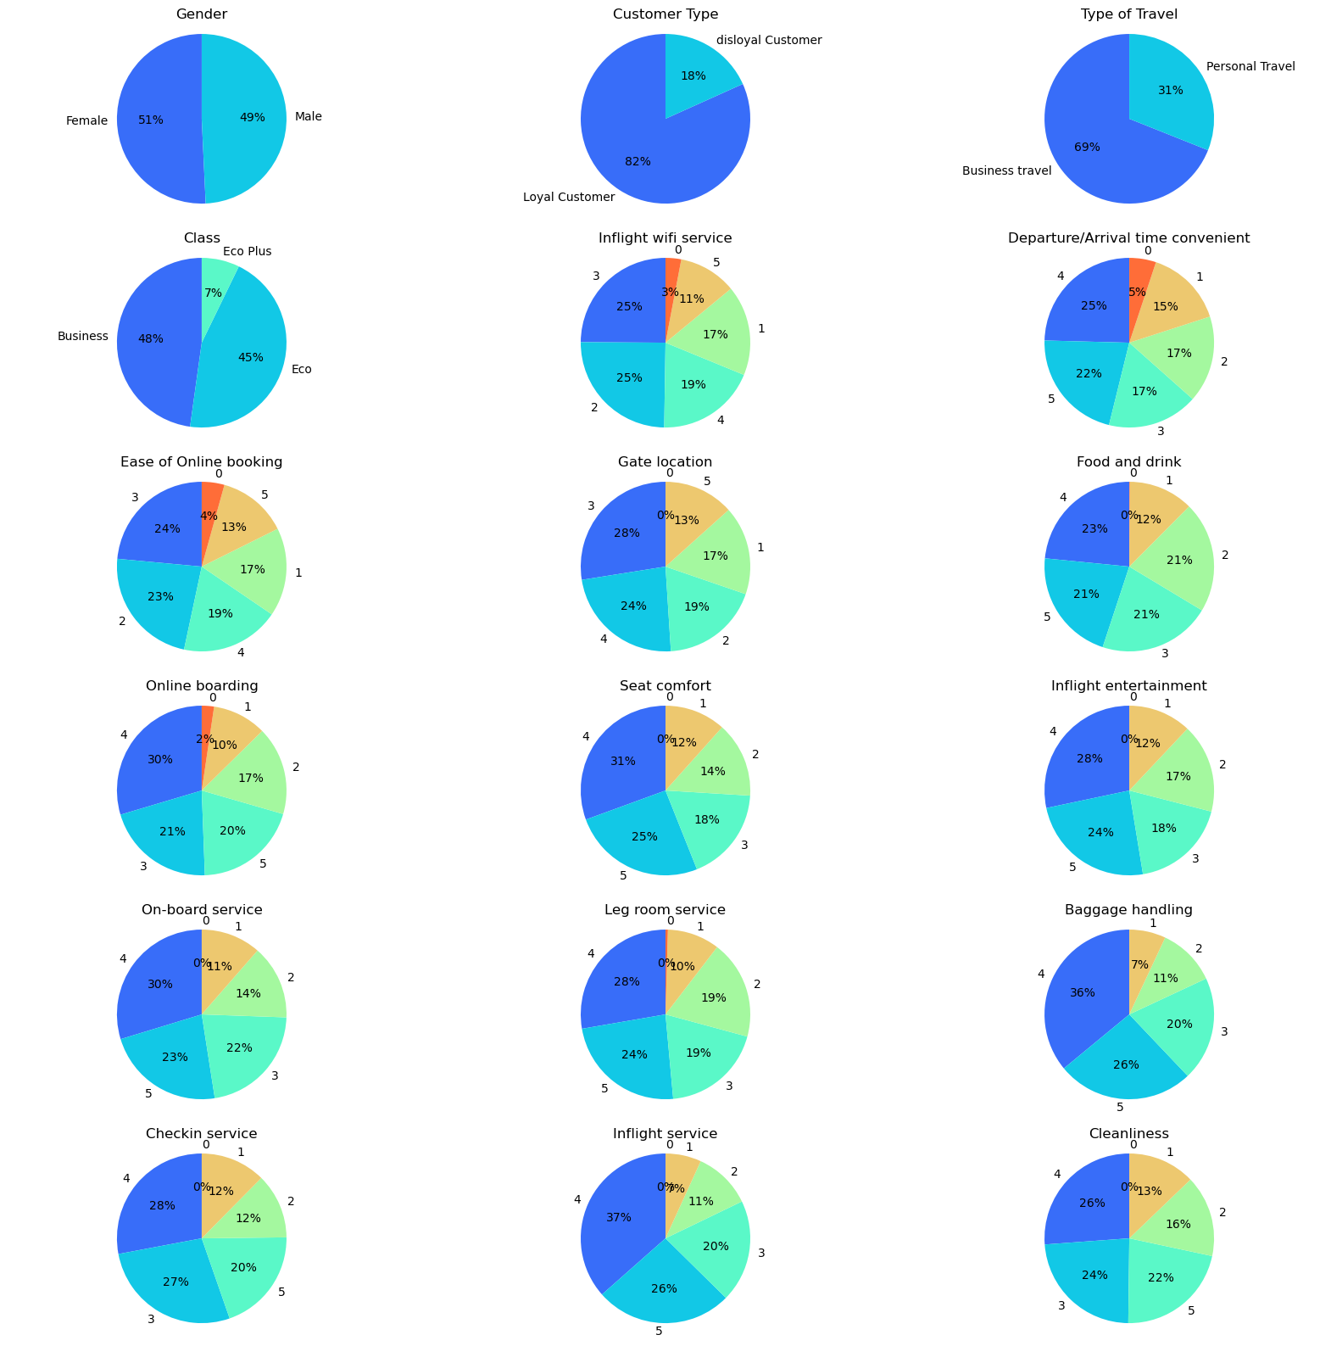
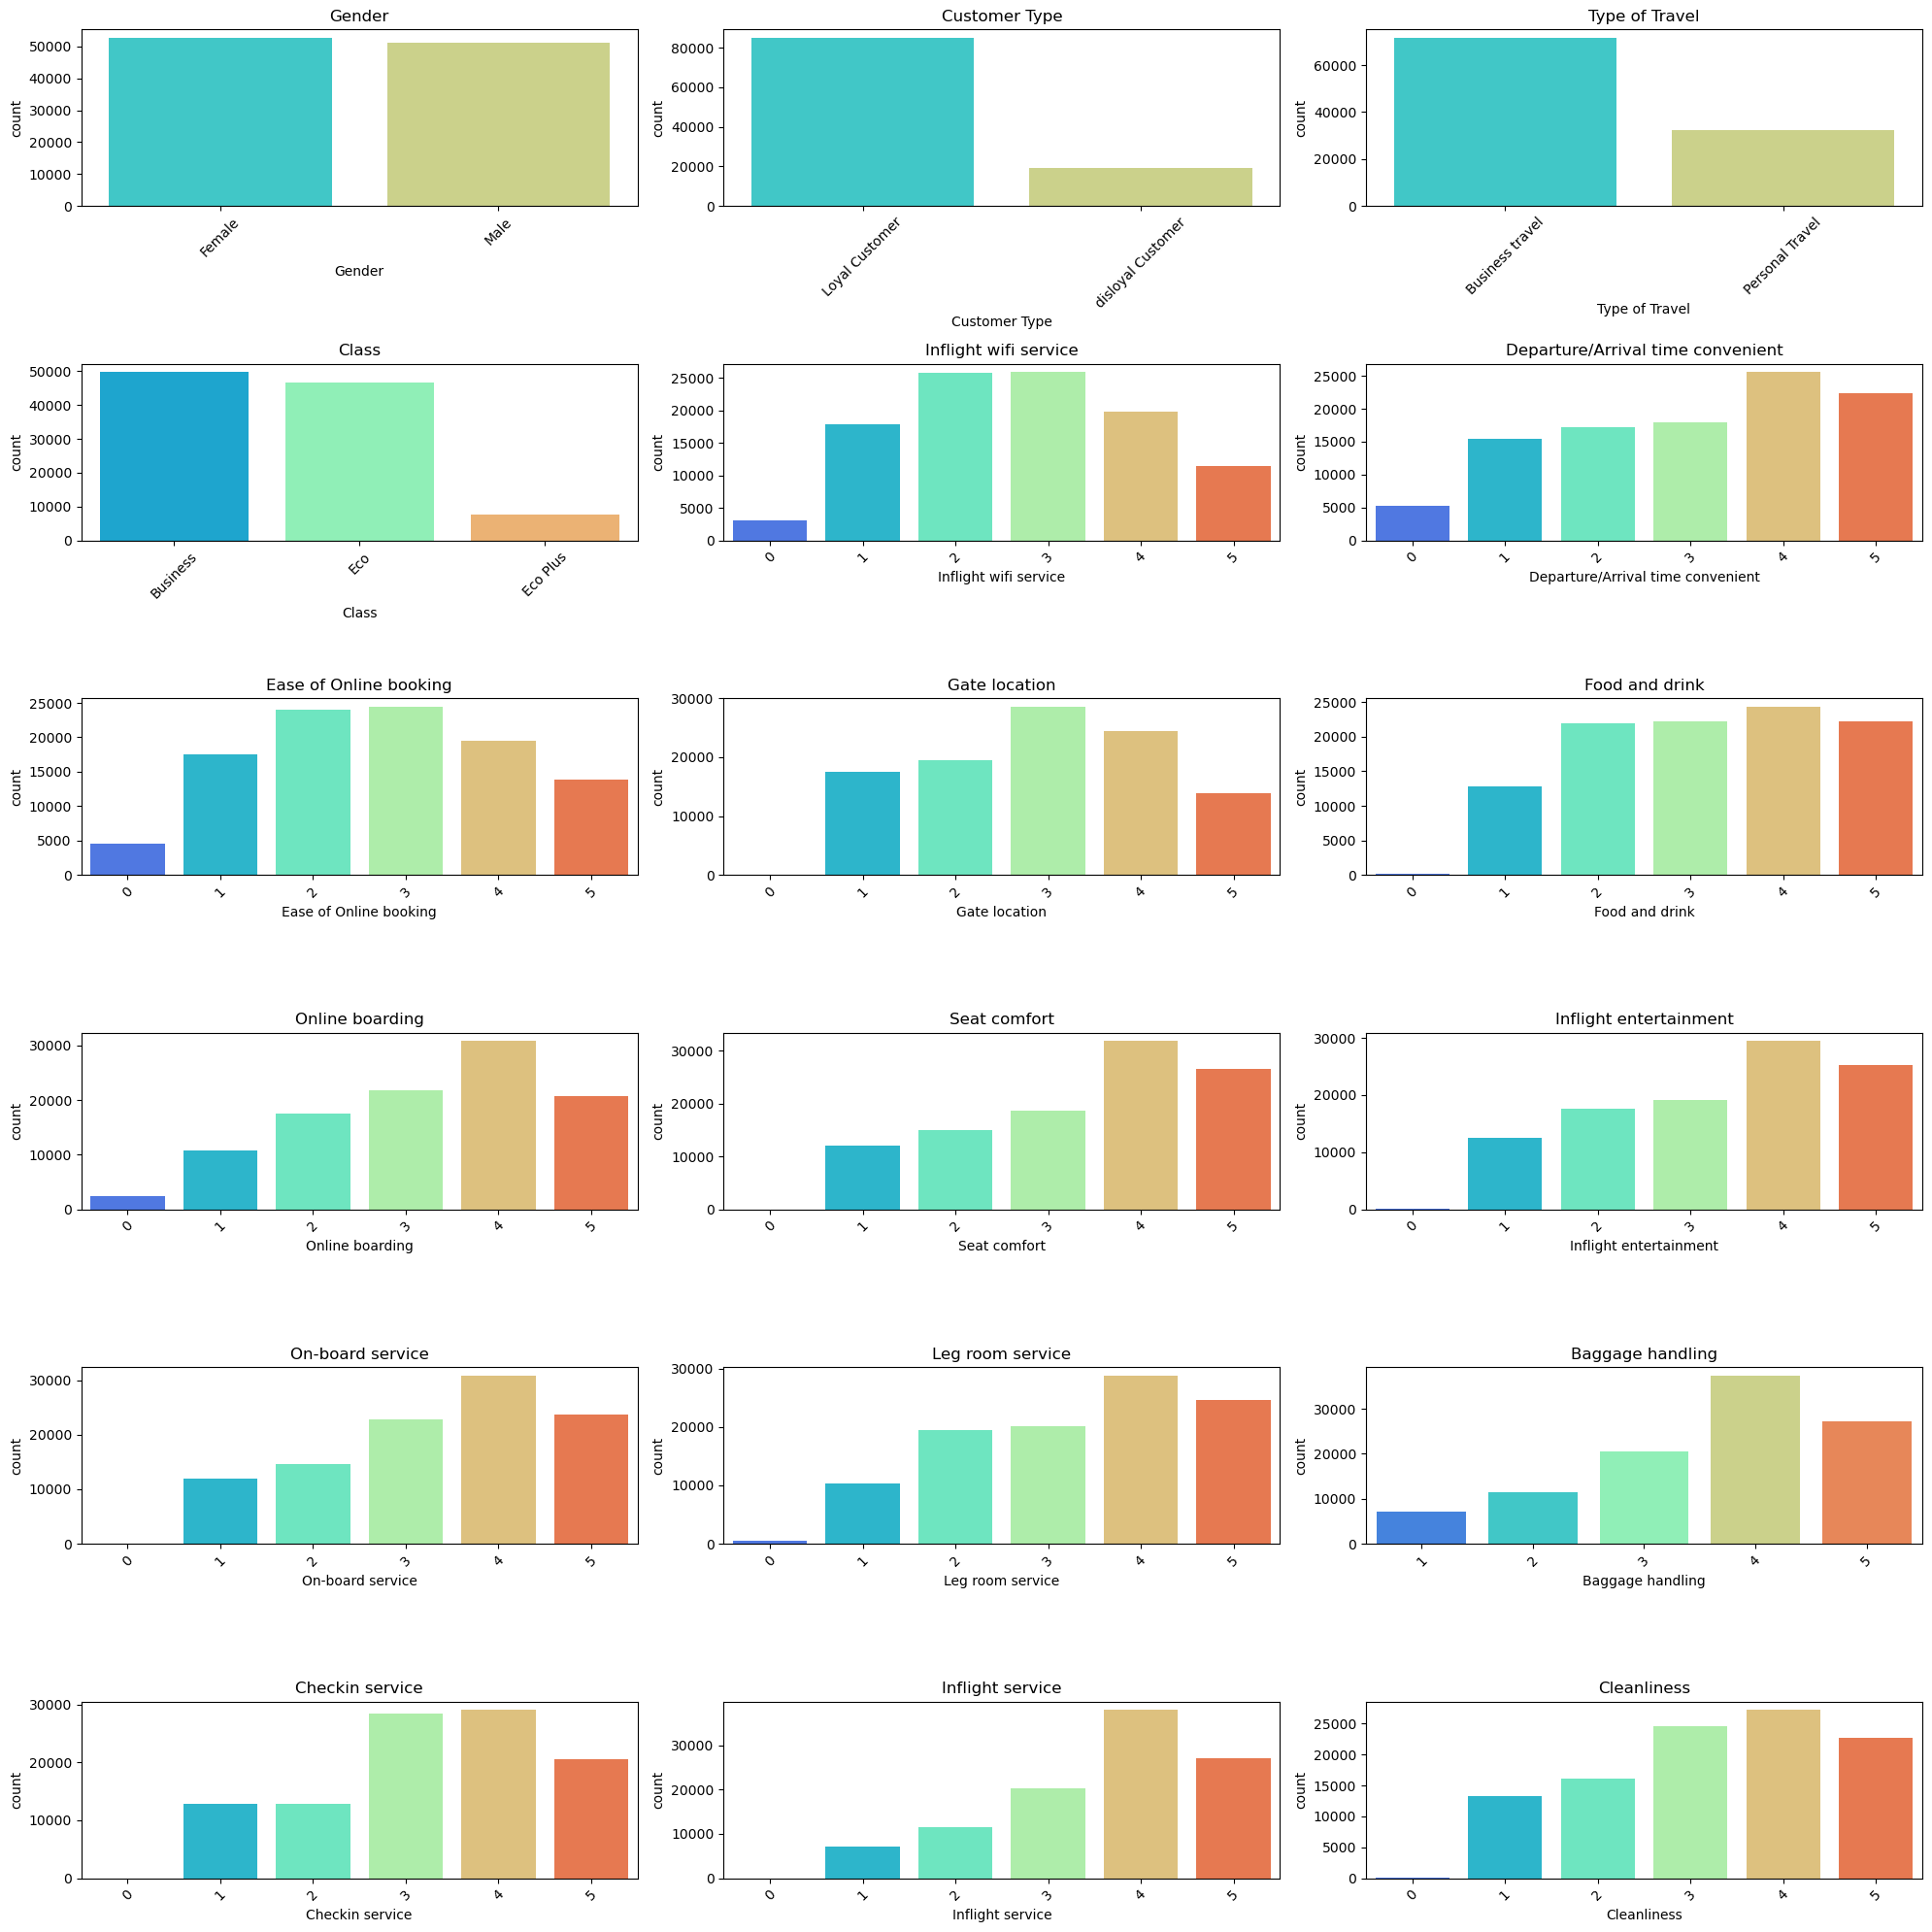

Slide 9
Data Preprocessing

Slide 10
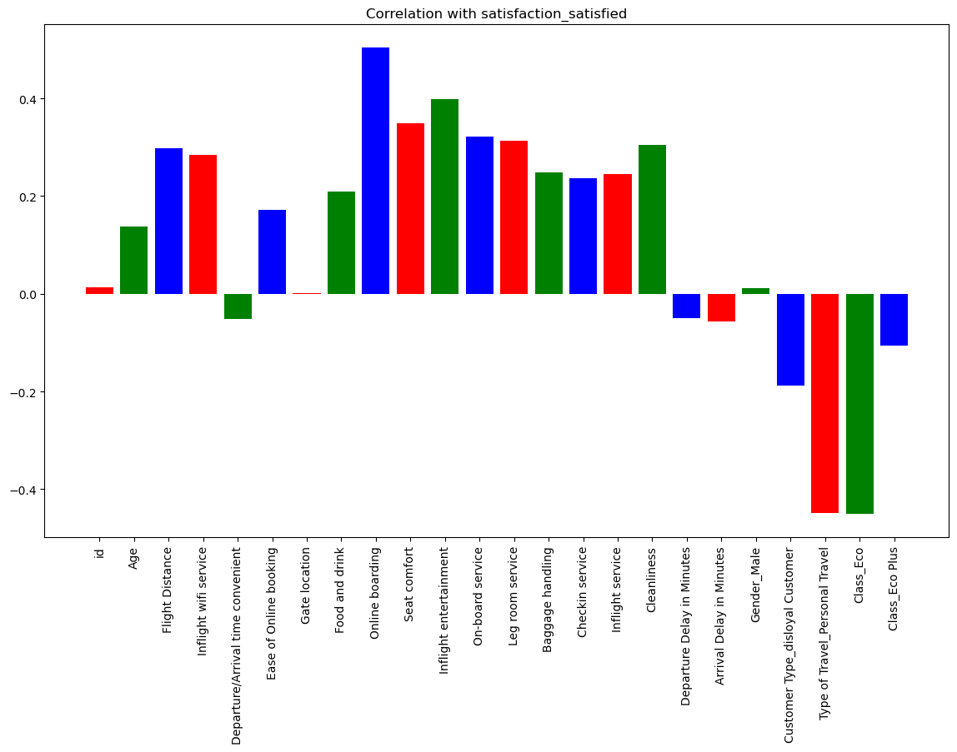

Slide 11
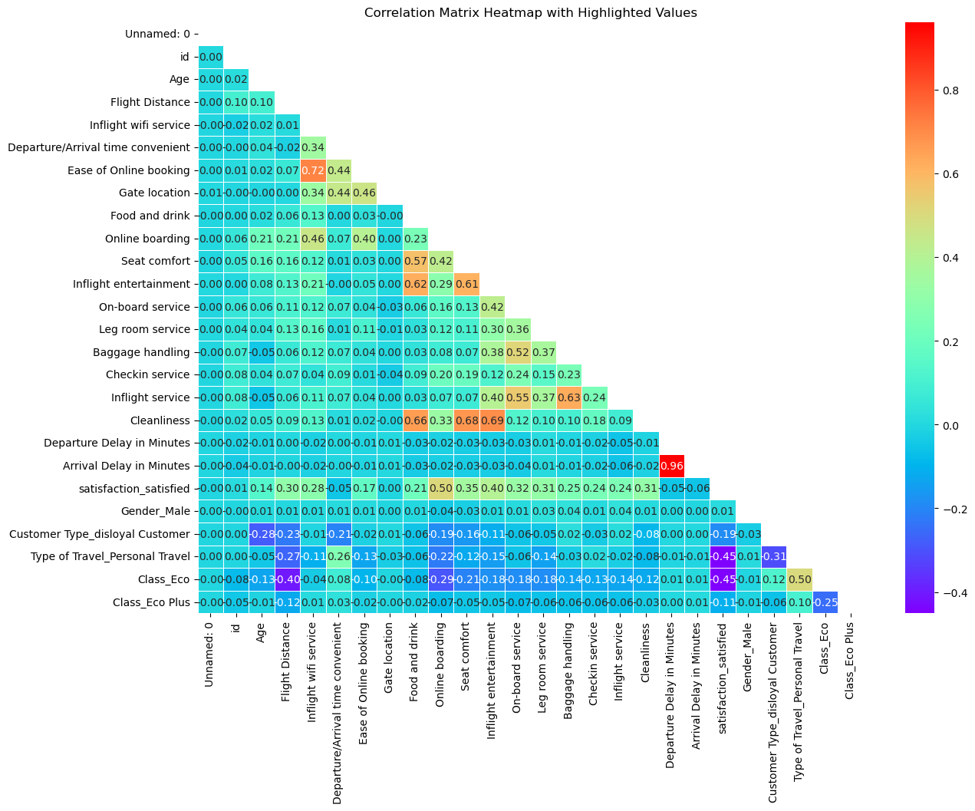

Slide 12
Feature selection
Logistic Regression Model
Random Forest Model

Slide 13
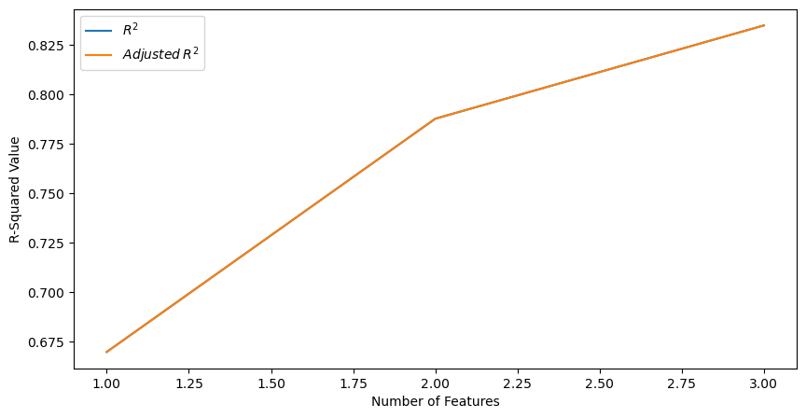
Logistic regression
Resulting features:
Online boarding,
Type of Travel_Personal Travel,
Inflight wifi service,
Logistic Regression Model Score : 0.8476285802279027
Random Forest Model Score : 0.89

Slide 14
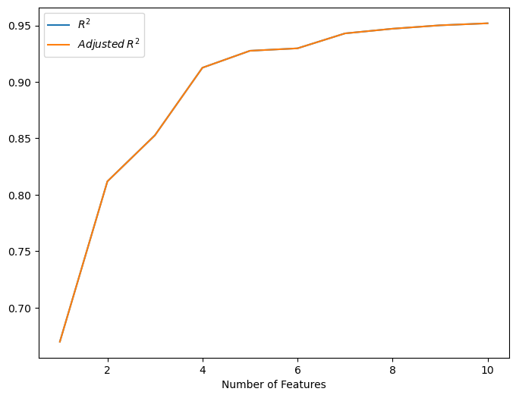
Random forest
Resulting features:
Online boarding,
Type of Travel_Personal Travel,
Inflight wifi service,
Gate location,
Inflight service,
Customer Type_disloyal Customer,
Baggage handling,
Checkin service,
Class_Eco,
Class_Eco Plus
Logistic Regression Model Score : 0.8644806744687403
Random Forest Model Score : 0.96

Slide 15
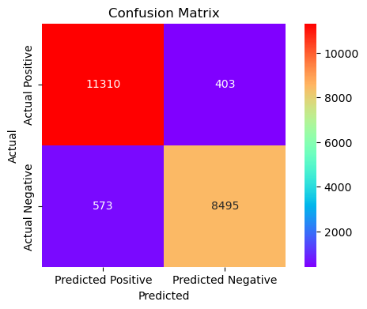
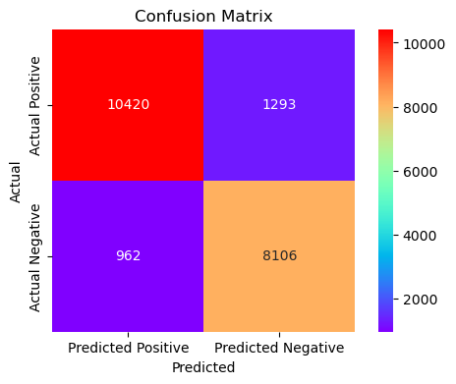

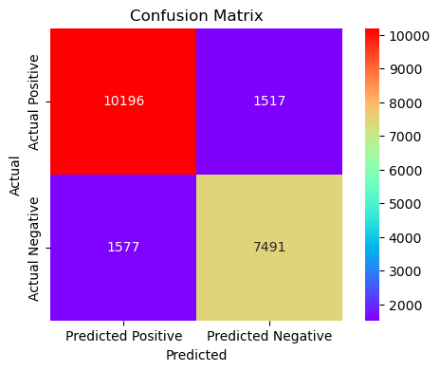
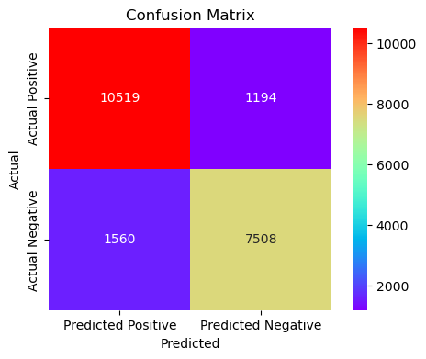
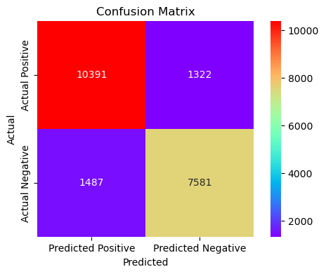
Decision Tree Accuracy Score: 0.95
Random Forest Accuracy Score: 0.96
KNN Accuracy Score: 0.94
Naïve Bayes Accuracy Score:
0.8511139983638901
SVM Accuracy Score: 0.87
Logistic Regression Accuracy Score: 0.8644806744687403

Slide 16
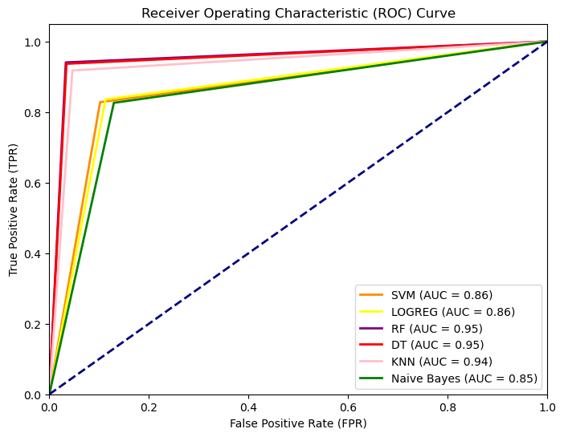

Slide 17
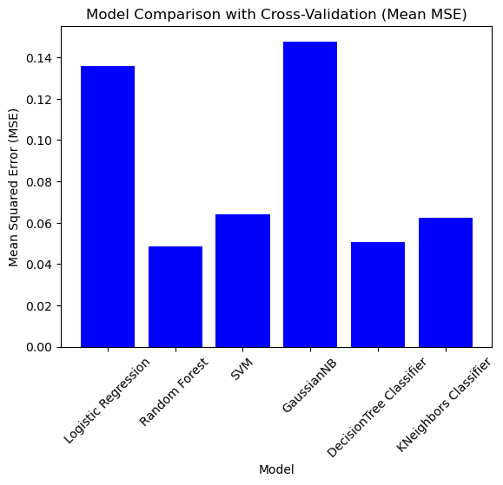
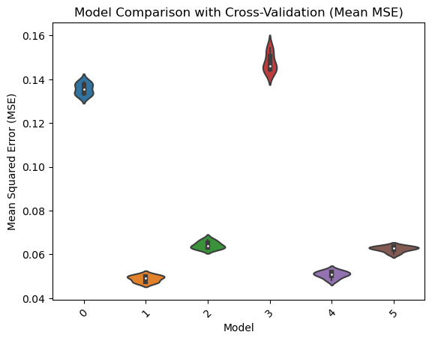

Slide 18
Decision tree vs random forest
Decision Tree | Random Forest
A decision tree is a tree-like model of decisions along with possible outcomes in a diagram. | A classification algorithm consisting of many decision trees combined to get a more accurate result as compared to a single tree.
Prone to overfitting, especially when the tree is deep and complex. It can capture noise in the data. | Less prone to overfitting due to the aggregation of multiple trees. It tends to produce more generalizable models.
The results are not accurate. | This gives accurate and precise results.
Tends to have high variance and low bias, which means it can adapt well to the training data but may perform poorly on unseen data. | Reduces variance compared to a single Decision Tree, resulting in a more balanced trade-off between bias and variance. It often provides better generalization.
It is easy to visualize. The only task is to fit the decision tree model. | This has complex visualization as it determines the pattern behind the data.
May have lower prediction accuracy, especially when the data is complex or noisy. | Tends to provide better prediction accuracy, making it a popular choice for many real-world applications.

Slide 19

Random forest

Slide 20

Thank you

